Slide 1

Team
TW Insurance
May 19, 2021

Slide 2

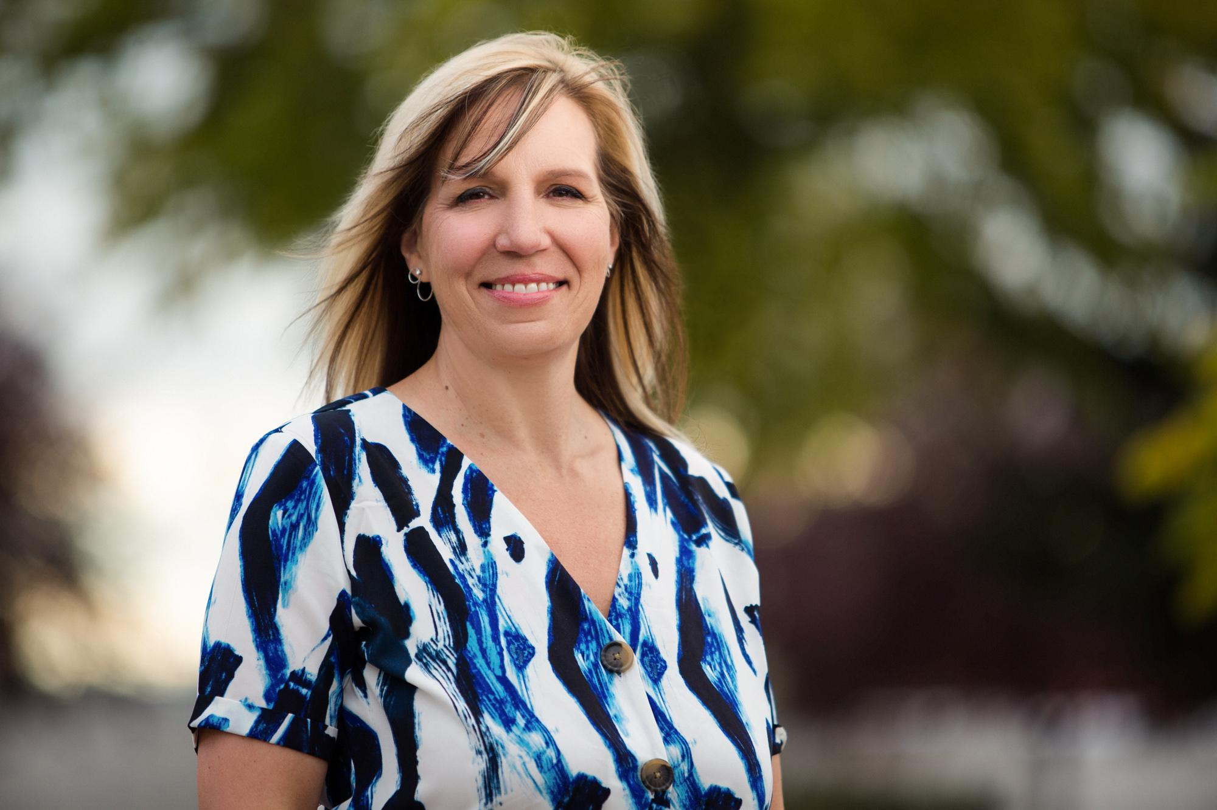
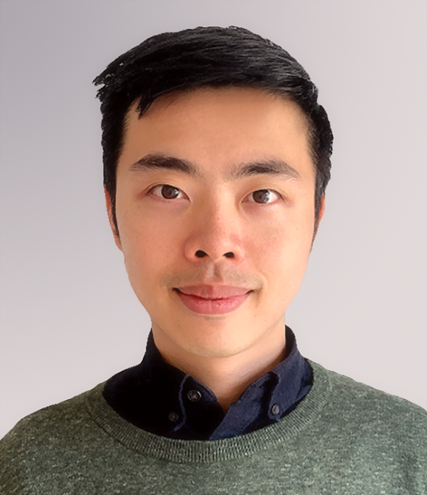
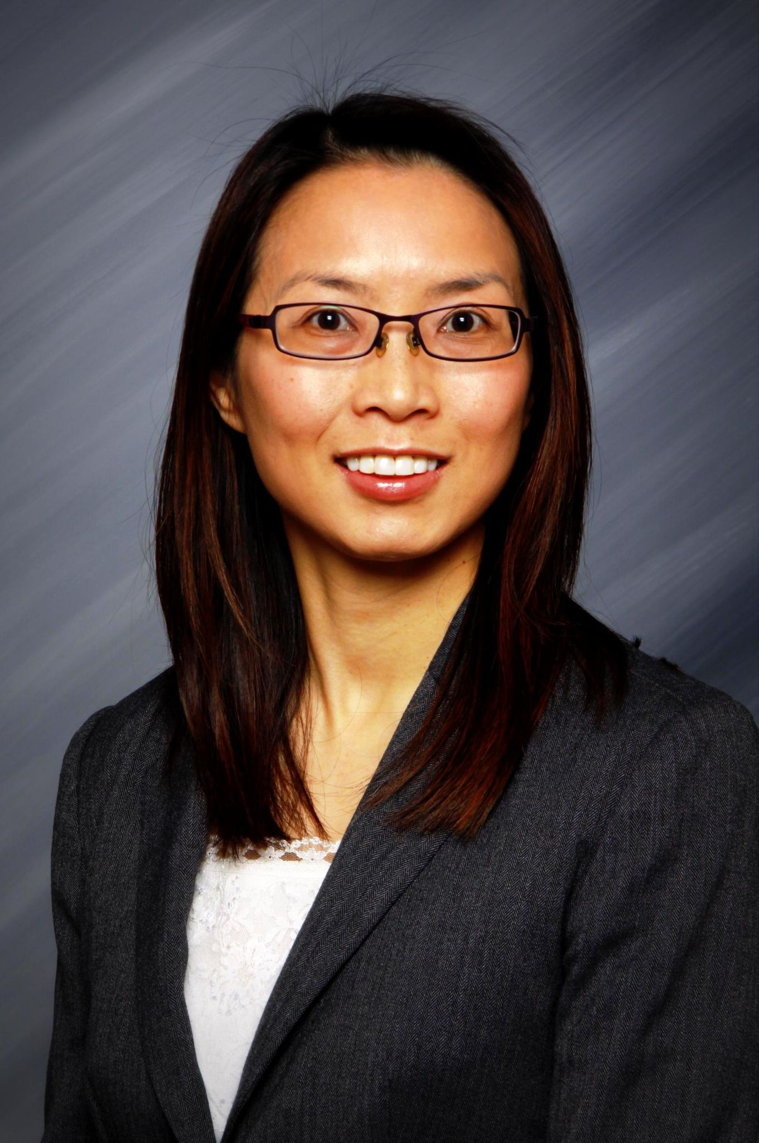


Laurie Bauer
Dennis Lee
Emily Mininger
Summer Hack 2021
Team TW Insurance
MEET the TEAM
Gouri Kulkarni
Ayman Omar
Rubie Ling

Slide 3

How Might We Develop A Solution/Service To Cater To The Growing Underserved Population?
CHALLENGE #2
Access to Insurance

Slide 4

THE PROBLEM
How Might We Ensure That Nancy Is Welcomed With All Necessary Insurance Products Upon Arrival Without Nancy Worrying About A Language Barrier?
We are
Team
TW Insurance

Slide 5

OUR JOURNEY
We interviewed newcomer students to Canada and came up with their pain points and cooked up a solution to solve their problems!

Slide 6

WHAT WE DID
48 Ideas In 5 Minutes
2 Newcomers Interviewed
1 Sketch Of Solution
1 Lo-fi Level 2 Prototype

Slide 7
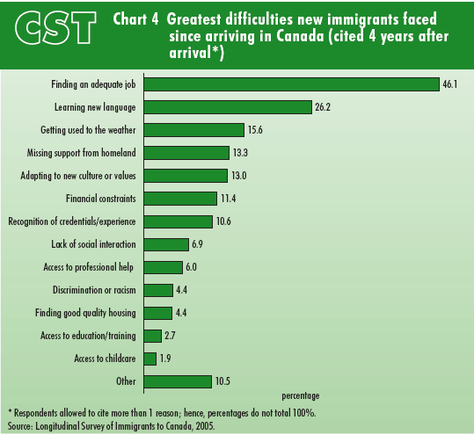
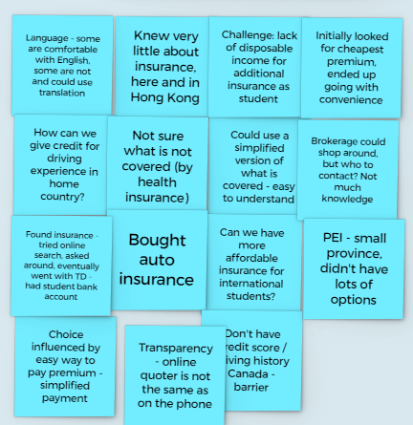
Research Insights

Slide 8
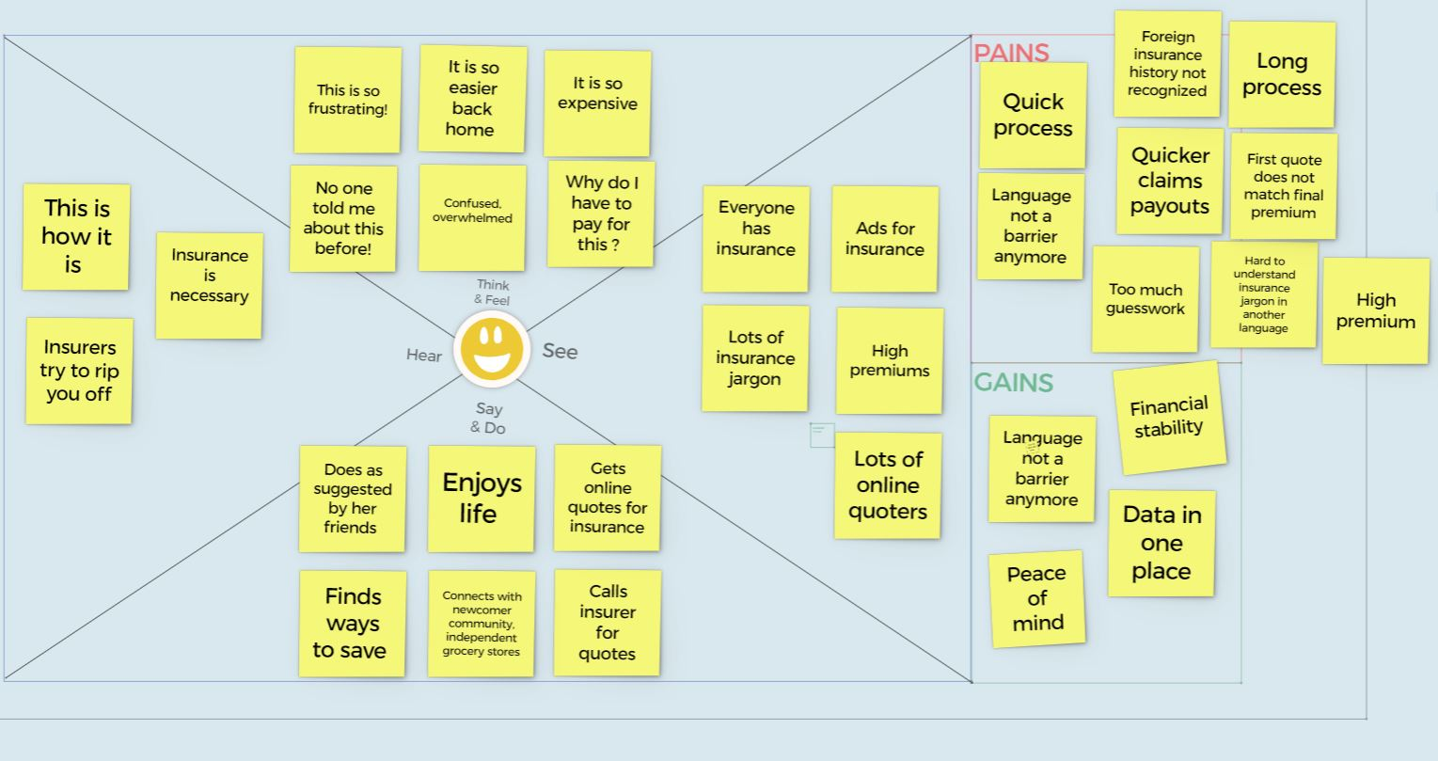
EMPATHY MAP

Slide 9
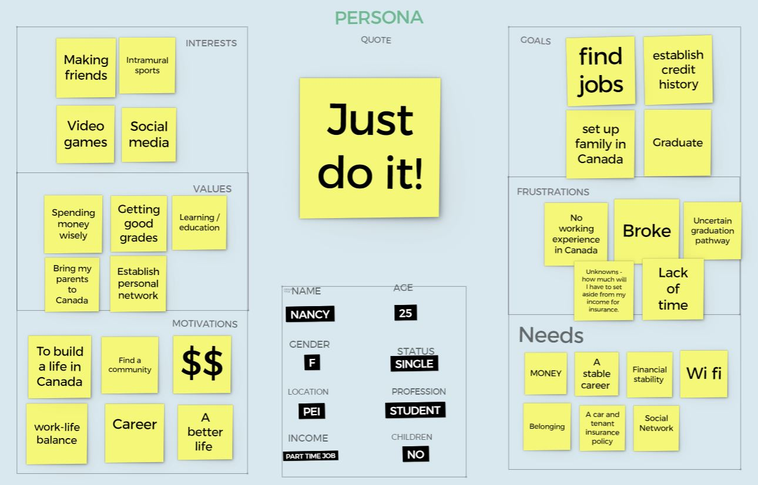

PERSONA

Slide 10
"There Is No Insurance Tool Or Online Community That Is Designed For 400,000+ Newcomers To Canada Each Year.”

Slide 11
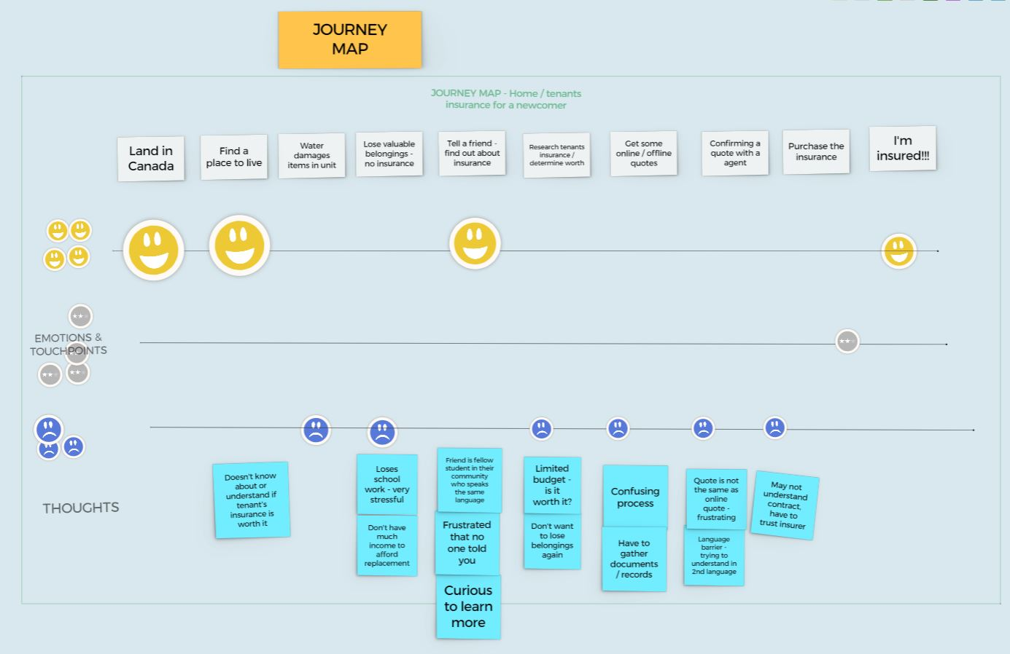
JOURNEY MAP

Slide 12

How might we ensure that newcomer Nancy is welcomed with all necessary insurance products upon arrival without Nancy worrying about a language barrier?

Slide 13
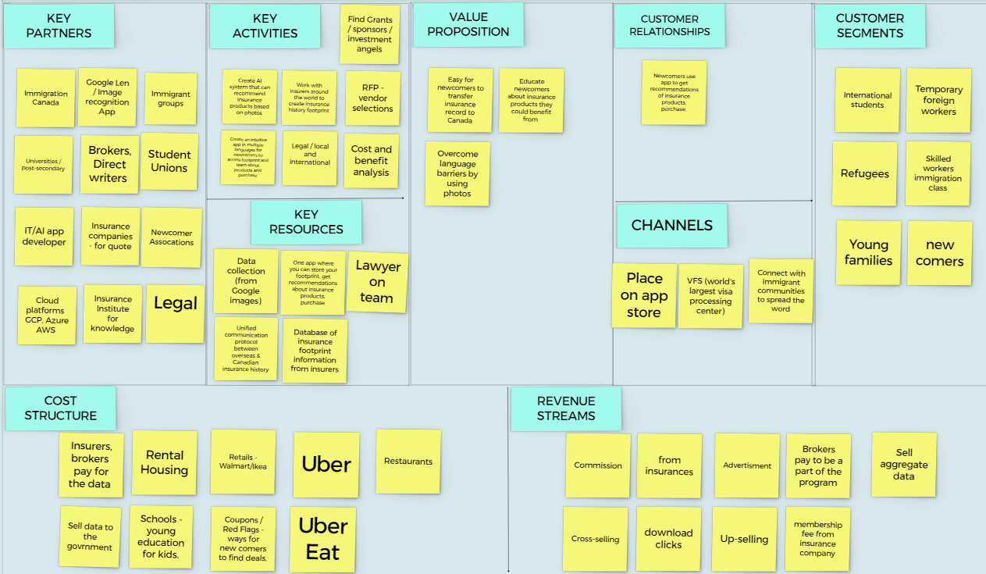
Business Canvas

Slide 14
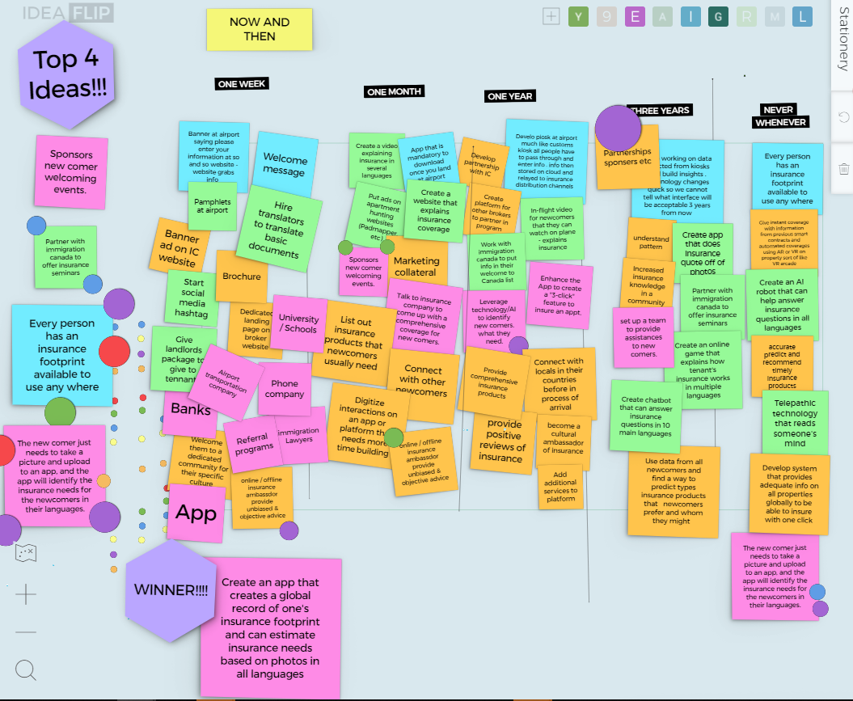
Our Solution Ideas
1 month
1 year
3year

Slide 15
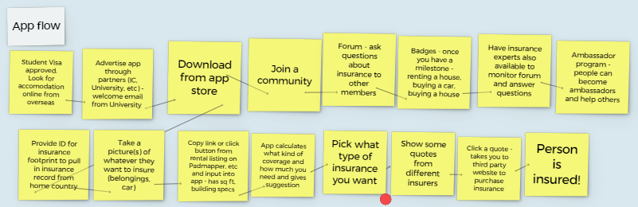

Slide 16
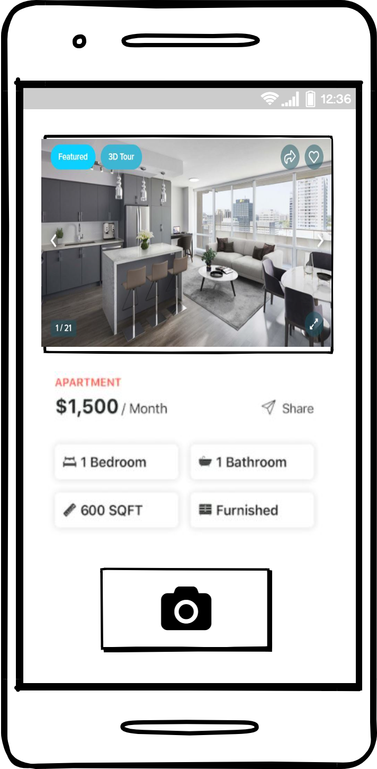
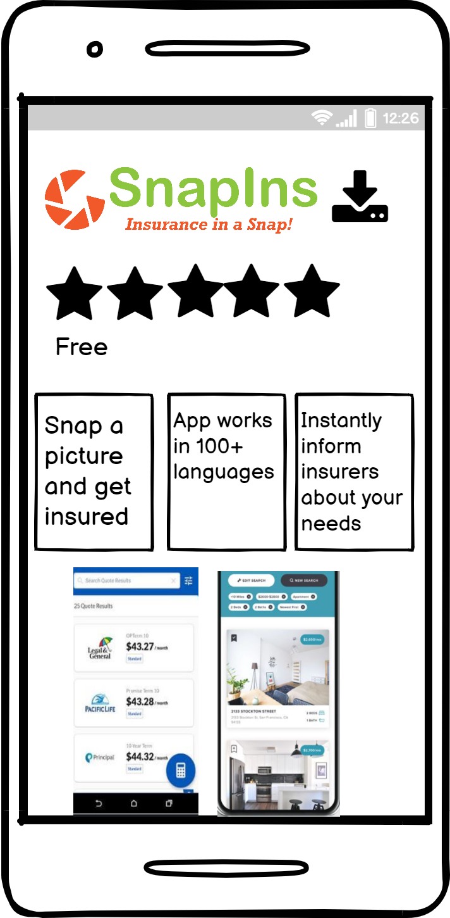

Slide 17



All languages available

Slide 18

All you have to do is ……..

Slide 19
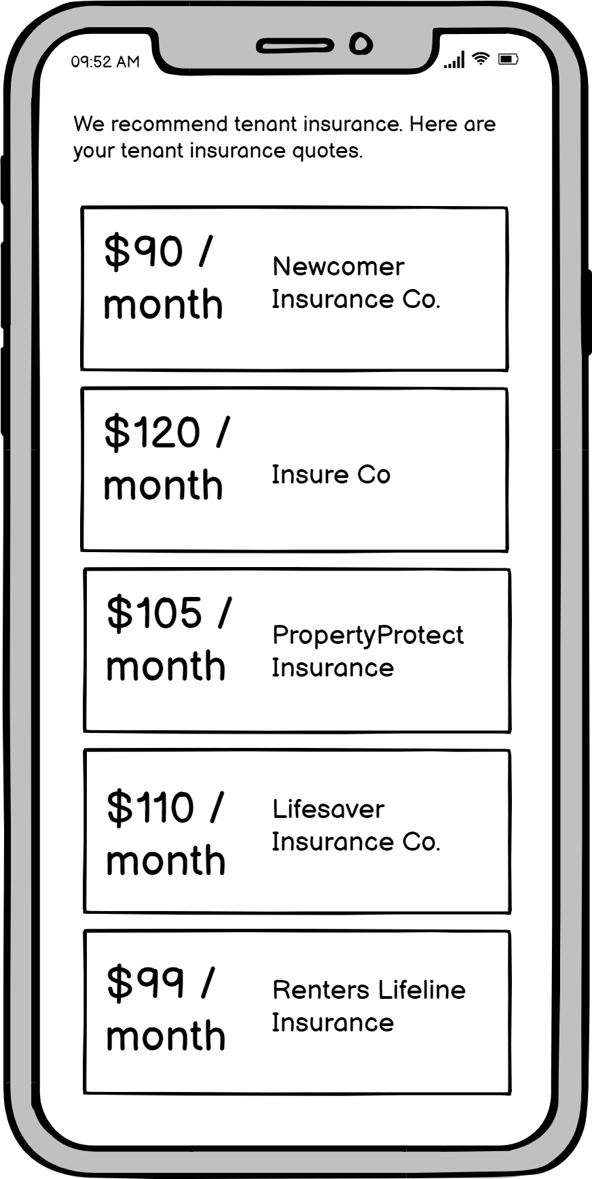
AI uses the photos you’ve provided to determine the coverage you need and recommend quotes.

Slide 20
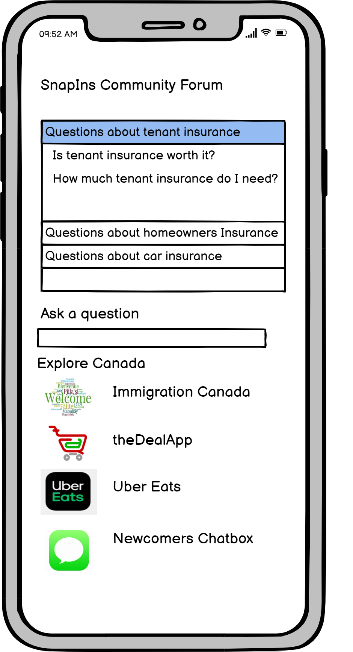
You can also use the app to access a community forum, where you can ask insurance questions and get answers from community members as well as insurance professionals.

Slide 21

What we learned!
Empathy is key to finding solution
Now and Then helps discovering opportunities.
How many pain points there can be in the process
Working together efficiently with professionals from different background

Slide 22

THANK YOU
May 19, 2021
Team TW Insurance

